Slide 1
Delivery App Simulator
Project Guide : V. Sai Chandana
Sk.Khajabi P.Lakshmi Priya

Slide 2
INTRODUCTION
The Delivery App Simulator is a Spring Boot–based application designed to emulate the core functionality of a real-world delivery platform. It enables customers to place orders, track delivery status, and view order history while ensuring accurate order processing and delivery management.
The system integrates REST APIs, MongoDB (or relational DB), Git for version control, and Postman for testing, making it suitable for both learning and demonstrating modern application development practices.

Slide 3
OBJECTIVES
Provide customers with the ability to place and manage delivery orders.
Ensure real-time tracking of delivery status (e.g., PENDING, IN_TRANSIT, DELIVERED)
Maintain accurate order and delivery history for users.
Support development and testing with Git version control and Postman collections.

Slide 4
KEY FEATURES
Item Management – Add, update, and fetch delivery items with pricing.
Order Management – Place, update, cancel, and view orders.
Delivery Tracking – Track delivery status in real time.
Order History – Retrieve complete order history for any customer.
Modular API Design – Built with Spring Boot REST APIs following OOP principles.
Database Persistence – Store and retrieve orders, deliveries, and items reliably.

Slide 5
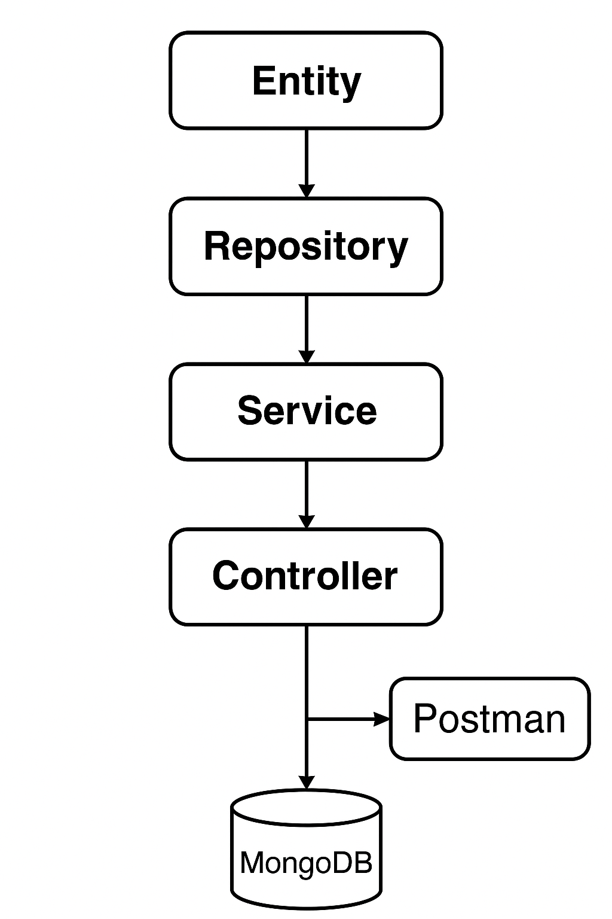
Structure

Slide 6
TOOLS AND TECHNOLOGIES
1.SpringBoot
4.Git
2.MongoDB
5.Maven
6.Spring Data JPA / Spring Data MongoDB
3.Postman

Slide 7
SPECIFICATIONS
HTTP Method
Description
Endpoint
POST
/orders
Place a new delivery order.
GET
/orders/{id}
Retrieve details of a specific order
PUT
/orders/{id}
Update order details.
DELETE
/orders/{id}
Cancel an order.

Slide 8
HTTP Method
Endpoint
Description
Fetch all past orders for a customer.
GET
/orders/history/{userId}
Check the delivery status of an order.
GET
/delivery/{orderId}/status
Update the delivery status (functionality implied)
PUT
/delivery/{orderId}/update
Retrieve available delivery items
GET
/items
Add a new delivery item (admin functionality)
POST
/items/add
Update an existing delivery item.
PUT
/items/{id}

Slide 9
THANK YOU…

